Slide 1

Research Project WS 22/23
Arnova Abdullah
Weekly Meeting – 21.02.2023

Slide 2

Previous Weeks Meeting Details
Week 1 Meeting (19.10.2022)
Basics about Radio Access Network (History, parts of RAN for 1G, 2G, 3G, 4G)
Basics about Open RAN (Distribution unit, central unit, user plane, control plane, interfaces, front haul, mid haul, backhaul)
Open RAN risk analysis (Stakeholders of attackers-User, external attacker, cloud operator**, RAN operator**)
Week 2 Meeting (26.10.2022)
Installation of Kali Linux and Metasploitable
Atomic Red Team GitHub repository download
Research other open-source attack tools
Week 3 Meeting (02.11.2022)
Penetration testing using Kali Linux
Try Atomic tests by invoke-atomic
Get used to commands used for running a test
Research details about one of the attack tools - Infection Monkey
Read research papers on the risk of 5G open RAN
Week 4 Meeting (09.11.2022)
Finding the most relatable attacks from the MITRE ATTACK list (On going)
CyberOps course ongoing
Research paper by MOU

Slide 3
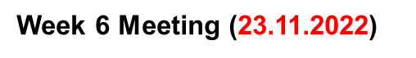
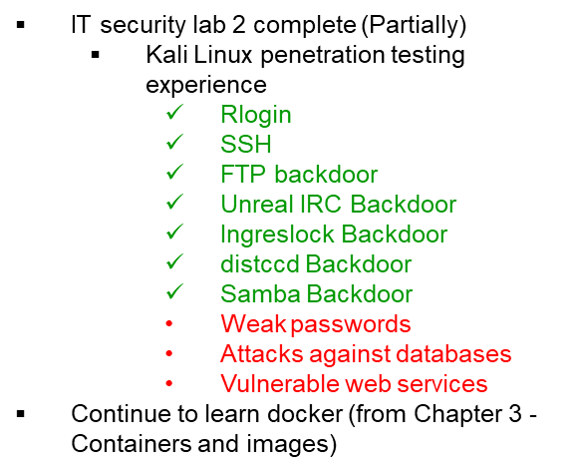

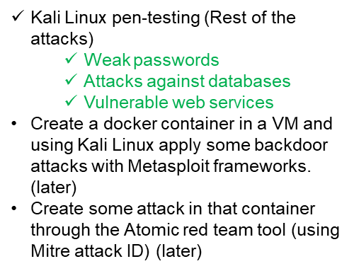
Previous Weeks Meeting Details
Week 5 Meeting (17.11.2022)
Install Infection monkey (Need AWS subscription, don’t continue anymore!!)
Start learning Docker container
https://developer.cisco.com/learning/tracks/containers/
https://learning.oreilly.com/videos/docker-fundamentals-for/9781803237428/9781803237428-video1_1/
Week 8 Meeting (08.12.2022)
Make a comparison between Kali Linux tools and Atomic Red Team
Select one to use at the end of the project
Week 9 Meeting (15.12.2022)
No update

Slide 4
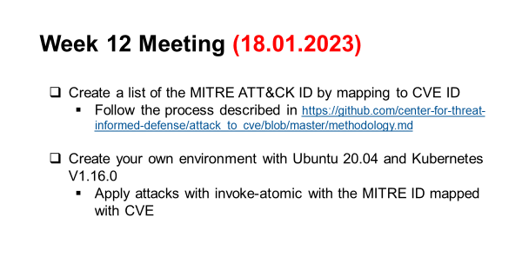
Previous Weeks Meeting Details
Week 10 Meeting (21.12.2022)
Research:
Is there a map between MITRE ID to CVE list?
In Kali Linux, is there any tool or settings to map CVE or MITRE ID?
Create an extended comparison between Atomic and Kali in MS Excel (Not done yet)
Create a list for Docker, and Kubernetes attacks:
How to attack the docker container? Which version?
What are the tools? (If required any)
What are the known vulnerabilities? (CVE, MITRE)
Create a list for Ubuntu:
Which Ubuntu version?
How to attack Ubuntu?
What are the tools? (If required any)
What are the known vulnerabilities? (CVE, MITRE)
Week 13 Meeting (25.01.2023)
Problem understanding Ubuntu OS configuration basics.
Week 14 Meeting (01.02.2023)
Install another VM with Ubuntu 20.04
Learn Kubernetes basic architecture
Learning about basic components
Week 11 Meeting (11.01.2023)
Research more about Vulmap.
Which type of attack can it do?
Install it in Kali Linux and have practical experience with it.
Do the lab of Docker from Devnet.
If it is installed, then try some attacks with kali and atomic by mapping to CVE/MITRE. Use the list from the previous page list. (Partially done!)
Weekly meeting (08.02.2023)
Go through this link
https://adamtheautomator.com/cri-o/
Open RAN Security: https://www.ericsson.com/en/security/security-considerations-of-open-ran
Continue learning Kubernetes and Open RAN components in parallel.

Slide 5
Weekly update - 21.02.2023
I again started learning Kubernetes from the beginning as there was some confusion while learning cluster architecture. I tried to learn deeply about each component and object of Kubernetes. (next page)
In the meantime, I am preparing for the IT Security final exam (24th February) and I was trying to relate cellular security with IT security in terms of different protocols.
For example, cellular techs (3g, 4g, 5g) are actually similar to layers 1 & 2 of the OSI/ISO layer but not identical.
I learned about different attacks in layers 1 & 2 and some security protocols in these layers.
I have taken the link for the implementation of the near real-time RIC and non-real-time RIC from Mohammed so that I can give it a read about the components of near real-time RIC and the protocol stack.

Slide 6
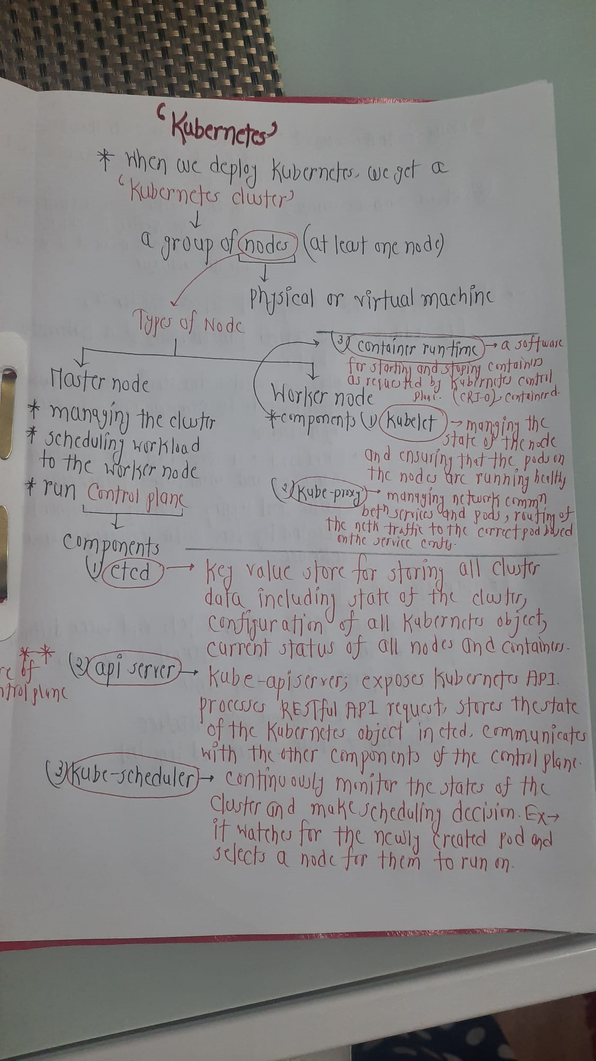
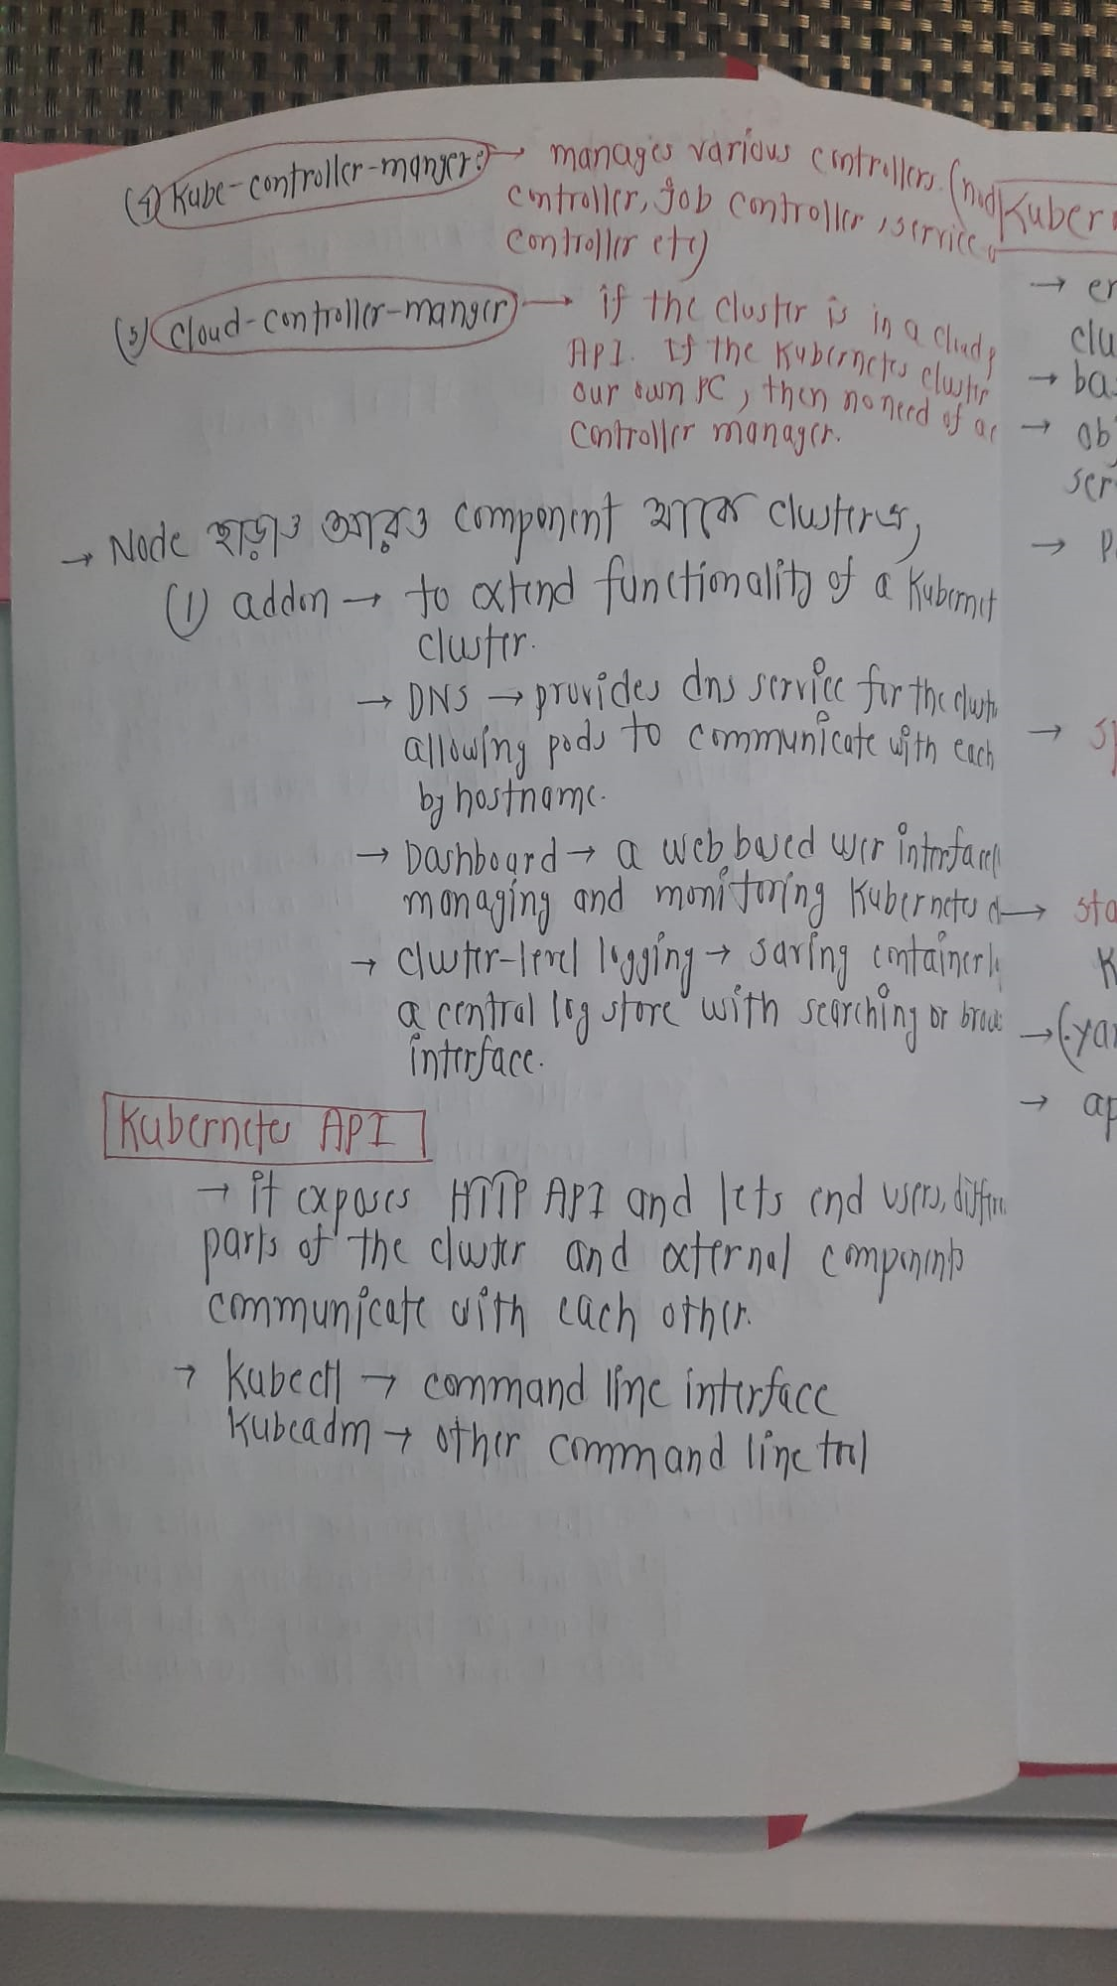
So I tried to know the components of Kubernetes in a detailed way so I wrote everything down

Slide 7
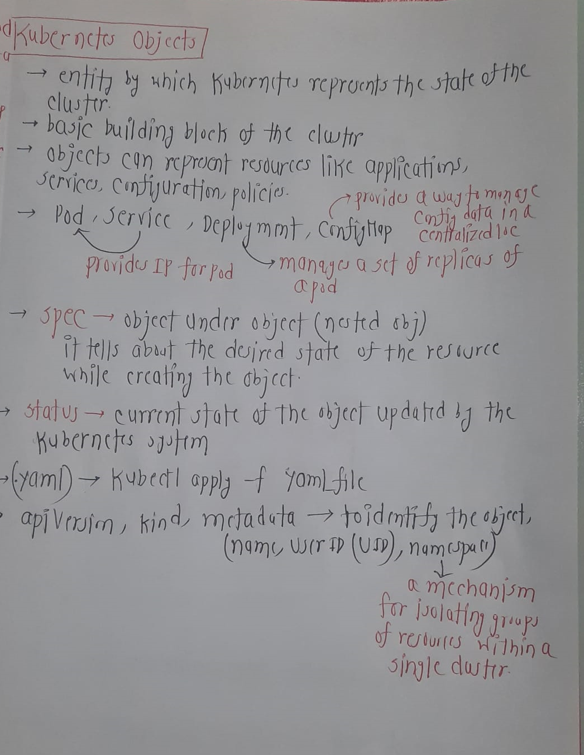
So, I tried to know the components of Kubernetes in a detailed way so I wrote everything down.

Slide 8
Next Week (2nd March)
After the exam I will continue to take notes and learn Kubernetes from the part left.
As Mohammed said to me last week, he deployed the near real-time RIC so I will look into the components of it so that at the minimum I can detect some vulnerabilities of the components that are already deployed.

